Slide 1

Exploratory Data Analysis
Property Portfolio Strategy for
Data-Driven Recommendation
By:
Vaibhav Redekar
Date: 20-10-2025

Slide 2
Contents
01
02
Summary
Price adjustment effectiveness
03
04
Renovation ROI
Location Dominance
05
06
Property Recommendations
Future Scope

Slide 3


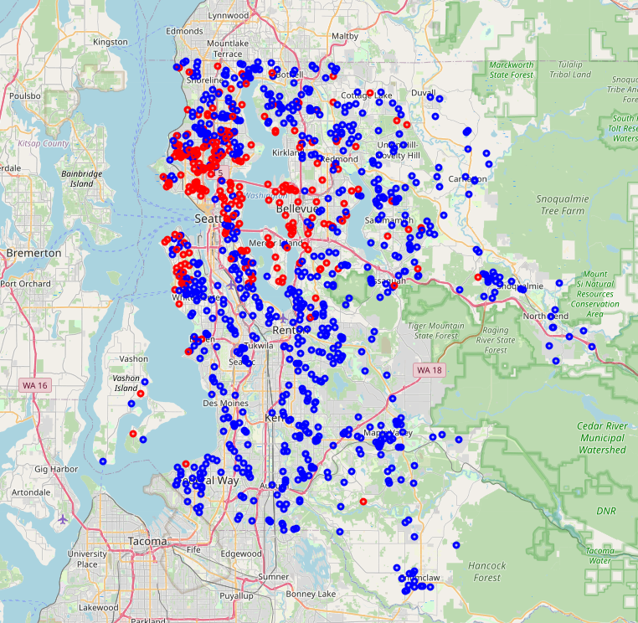
Summary
Top properties in Kings-County
Client:
Timothy Stevens
He owns multiple central expensive properties and need to:
Sell 3 properties within 12 months
Maximize returns with ensuring timely sales
Consider renovation where profitable

Slide 4
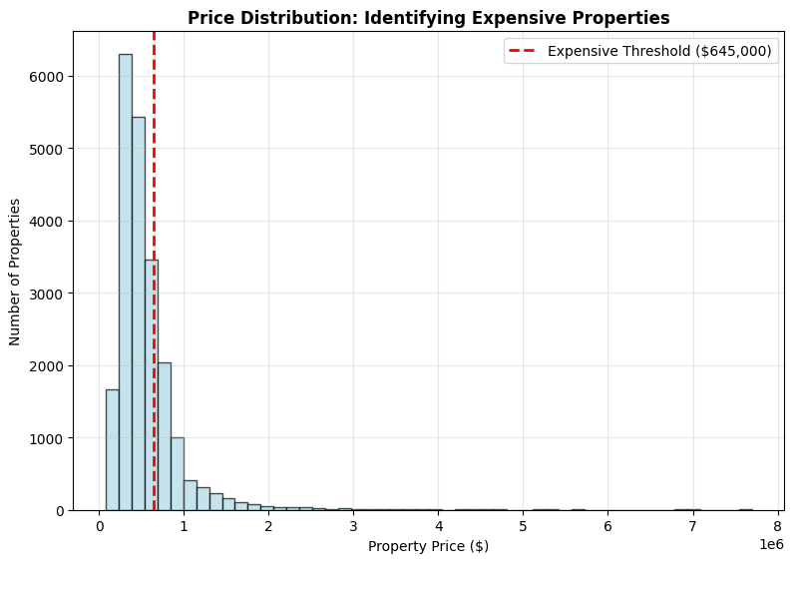
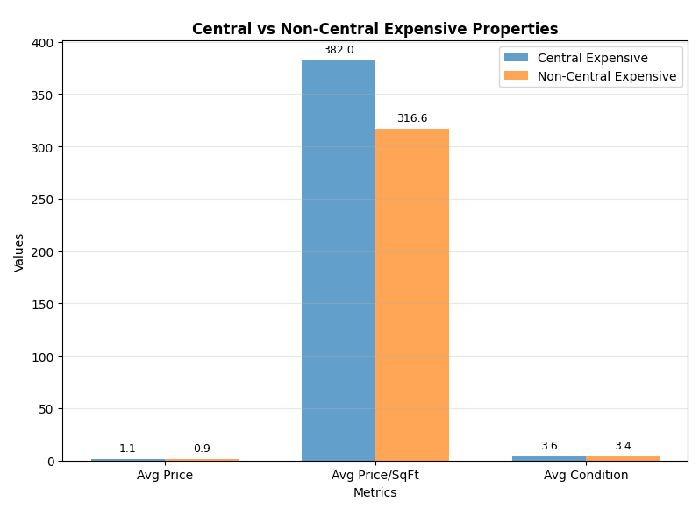
H1: Price Adjustment Effectiveness
“Price adjustment to the expensive apartments can cause a sale within a period of one year”
Do expensive properties take longer to sell?
What’s the optimal price reduction percentage
Are central expensive properties more sensitive to price changes?
Key Insights
Overpriced properties (top 10% price/sqft): 534
Recommended adjustment: 10-15% price reduction
Expected outcome: 30-50% faster sale probability

Slide 5
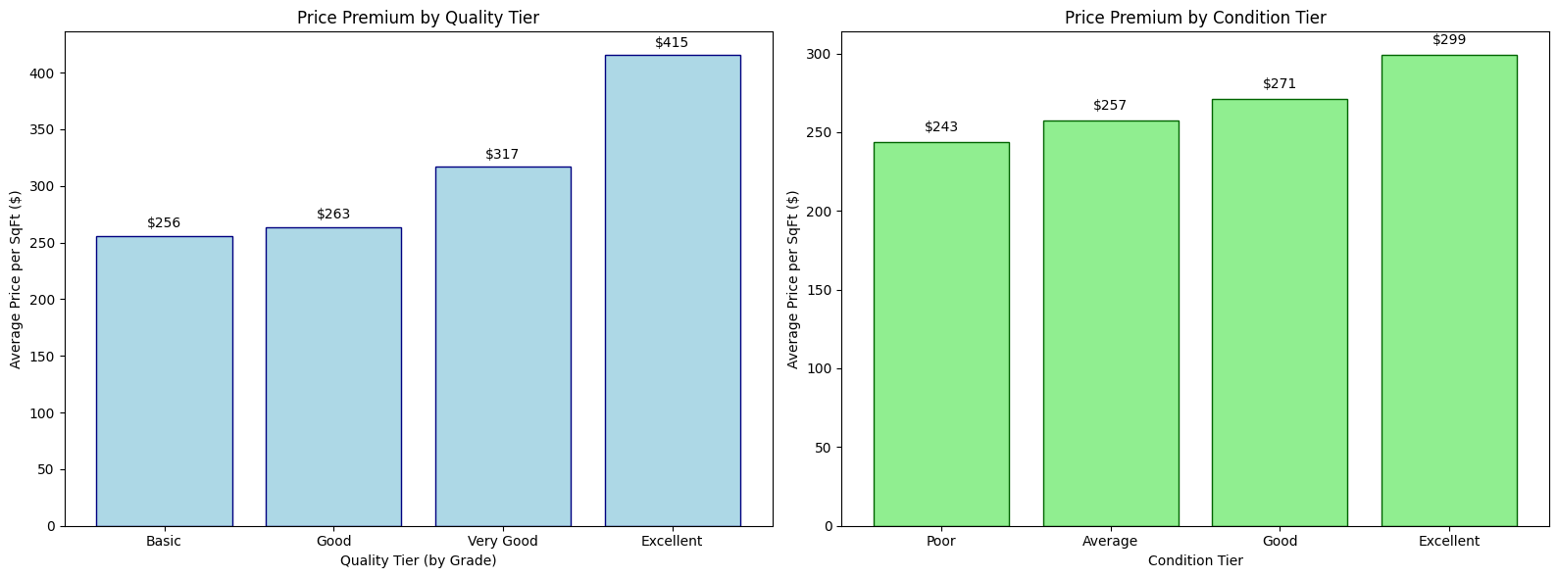
H2: Renovation ROI
“Renovating the current state of the apartments would lead to increase in profit margins”
Do renovated properties command price premiums?
Which renovation types yield highest ROI?
Is there diminishing returns on renovation quality?
Do expensive properties take longer to sell?
Basic | 0 - 7
Good | 7 - 9
Very Good | 9 -11
Excellent | 11 -14
Poor | 0 - 2
Average | 2 - 3
Good | 3 - 4
Excellent | 4 - 5

Slide 6
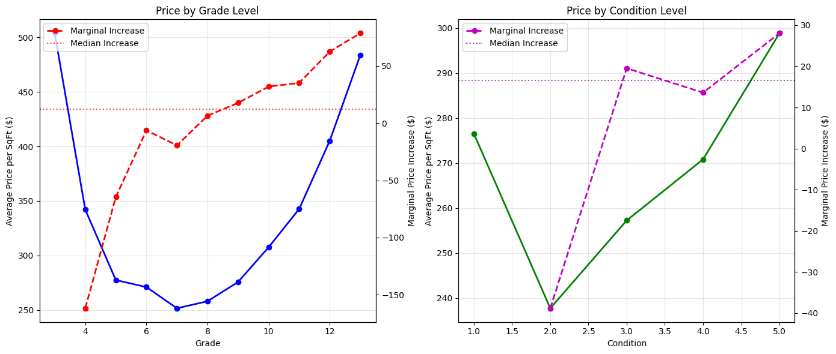
H2: Renovation ROI
“Renovating the current state of the apartments would lead to increase in profit margins”
Do renovated properties command price premiums?
Which renovation types yield highest ROI?
Is there diminishing returns on renovation quality?
Do expensive properties take longer to sell?
Key Insights
Grade diminishing returns start at: 4
Condition diminishing returns start at: 2

Slide 7
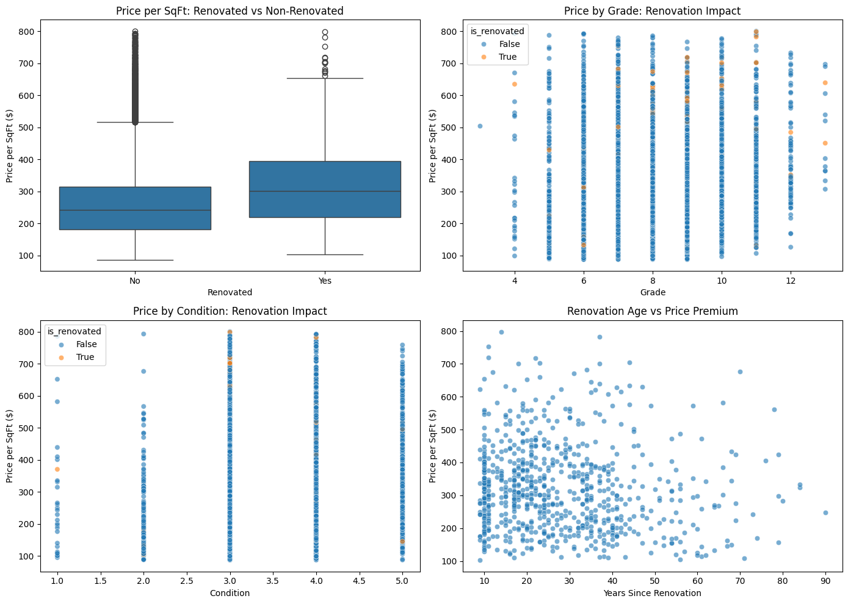
H2: Renovation ROI
“Renovating the current state of the apartments would lead to increase in profit margins”
Do renovated properties command price premiums?
Which renovation types yield highest ROI?
Is there diminishing returns on renovation quality?
Do expensive properties take longer to sell?
Key Insights
Renovation Premium:15-25% price increase
Best ROI:Condition 2-3 properties with Grade 9+ (60-80% ROI)
Diminishing Returns:Beyond Grade 11 and Condition 4

Slide 8
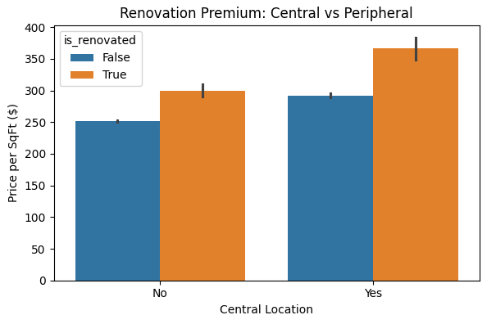
H2: Renovation ROI
“Renovating the current state of the apartments would lead to increase in profit margins”
Recommendation
Renovate 1 - 2 properties with highest ROI potential
Focus on aesthetic updates rather than structural changes.
Target 25-30% value increase post-renovation
Do expensive properties take longer to sell?
Key Insights
Renovations can increase profits when:
Target properties with good structure but poor condition
Budgeted at $125-200 per square foot
Focused on bedroom and bathrooms

Slide 9
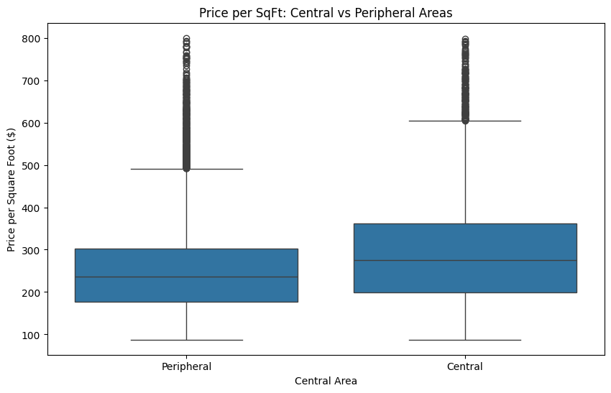
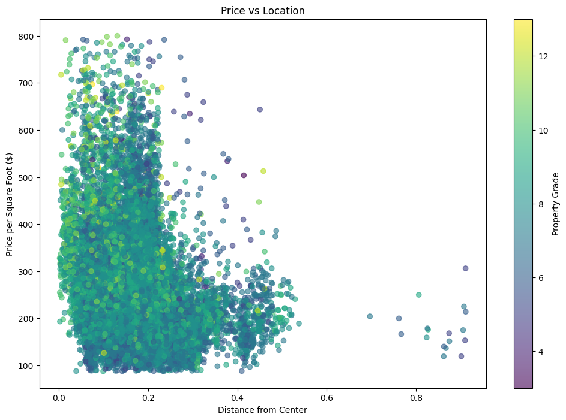
H3: Location Dominance
“Homes in central zip codes have higher prices regardless of grade or condition”
Is there a clear price gradient from center to periphery?
Do central properties outperform regardless of quality?
How strong is location compared to other factors?
Do expensive properties take longer to sell?
Key Insights
Geographic coordinates and price distribution
Distance from center vs price per sqft ; true center (i.e 20%) shows maximum premium
Central vs peripheral property comparisons

Slide 10
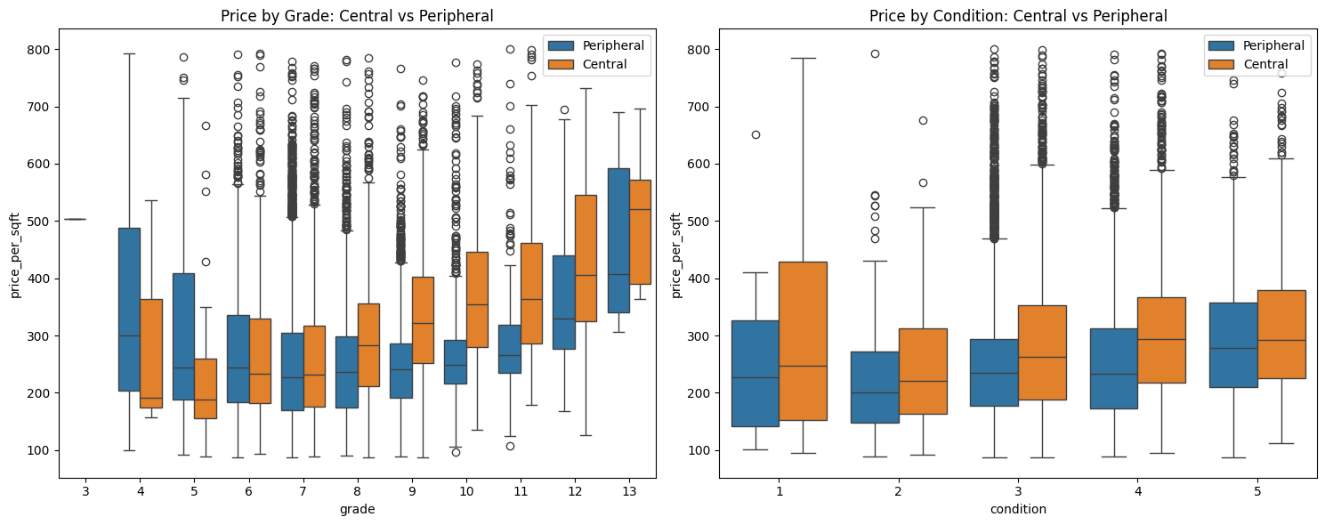
H3: Location Dominance
“Homes in central zip codes have higher prices regardless of grade or condition”
Is there a clear price gradient from center to periphery?
Do central properties outperform regardless of quality?
How strong is location compared to other factors?
Do expensive properties take longer to sell?
Key Insights
Location outweighs condition and grade combined

Slide 11
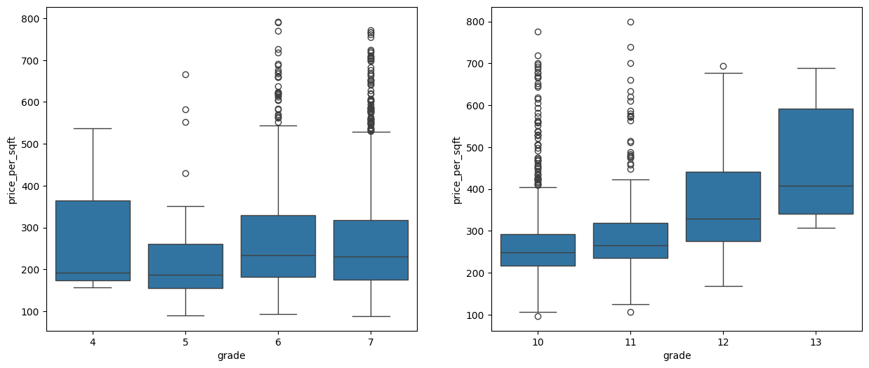
H3: Renovation ROI
“Renovating the current state of the apartments would lead to increase in profit margins”
Recommendation
Renovate 1 - 2 properties with highest ROI potential
Focus on aesthetic updates rather than structural changes.
Target 25-30% value increase post-renovation
Do expensive properties take longer to sell?
 | Type | Avg price sqft | Avg grade
0 | Central low grade | 260.557321 | 6.713899
1 | Peripheral high grade | 280.947988 | 10.300306
Key Insights
Central location more premiums

Slide 12
H3: Location Dominance
“Homes in central zip codes have higher prices regardless of grade or condition”
Recommendation
Focus sales efforts on true central properties
Use location as primary marketing angle
Maintain central property portfolio for long-term value
Key Insights
The red properties have the price per sqft greater than the rest 75% of properties.
Do expensive properties take longer to sell?

Slide 13
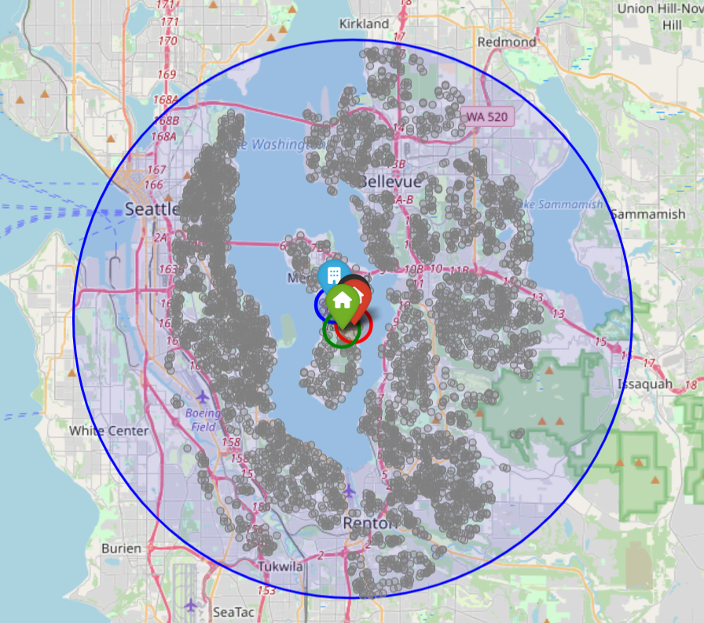
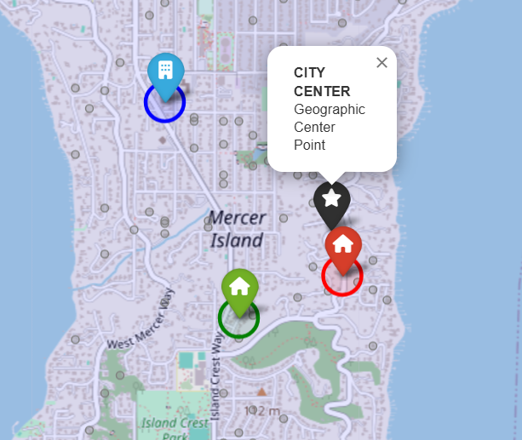
Top 3 Property Recommendations
Insights
Central Location
Black marks the geographical center point

Slide 14
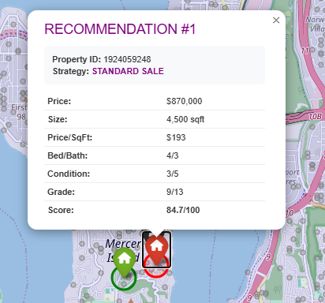
Top 3 Property Recommendations
Insights
Central Location
Insights
Rec. - 1
Black marks the geographical center point
Standard sale
No need for renovation
Overall grade and condition can be improved

Slide 15
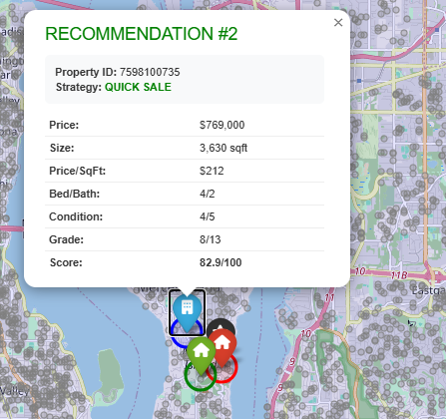
Top 3 Property Recommendations
Insights
Central Location
Insights
Rec. - 1
Insights
Rec. - 2
Black marks the geographical center point
Standard sale
No need for renovation
Overall grade and condition can be improved
Quick sale
Listed immediately
Good condition

Slide 16
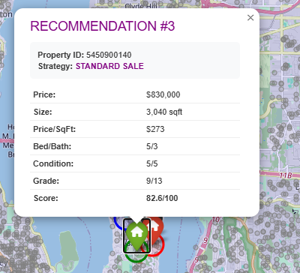
Top 3 Property Recommendations
Insights
Central Location
Insights
Rec - 1
Insights
Rec - 2
Insights
Rec -3
Black marks the geographical center point
Standard sale
No need for renovation
Overall grade and condition can be improved
Quick sale
Listed immediately
Good condition
Standard Sale
Very good condition & grade.
Time to sell depends upon the buyers

Slide 17
Based upon client data
Future Scope
Insights to Profit Margin
Predictive planning
The current analysis could be improvised for further accuracy depending on real client data.
Deeper insights could be obtained targeting real profit margins after sales and time to market in case of renovation.
Based on the historical data, buying of the properties in future could be also helpful to client based on future selling decisions and profits margins.

Slide 18
Thank you!

Slide 19
Extras

Slide 20
HYPOTHESIS 1 SIMPLIFIED ANALYSIS
==================================================
Question: Do price adjustments help expensive apartments sell within 1 year?
==================================================
Dataset Overview:
Total properties: 21420
Expensive threshold: $645,000 (top 25.0%)
Central threshold: 0.1266 distance units
Expensive properties: 5338
Central properties: 5355
ANALYSIS 1: Are expensive properties harder to sell?
==================================================
Price Segment Analysis:
price price_per_sqft condition grade
count median median median median
price_segment
<$500K 12437 340000.0 201.02 3.0 7.0
$500-750K 5424 600000.0 277.76 3.0 8.0
$750K-1M 2109 845000.0 293.16 3.0 9.0
$1-1.5M 938 1200000.0 362.37 3.0 9.0
>$1.5M 512 1885000.0 475.66 3.0 10.0
==================================================
ANALYSIS 2: Do central expensive properties behave differently?
==================================================
Central Expensive Properties: 2031
Avg Price: $1,148,380
Avg Price/SqFt: $382
Avg Condition: 3.6/5
Non-Central Expensive Properties: 3307
Avg Price: $889,788
Avg Price/SqFt: $317
Avg Condition: 3.⅘
==================================================
ANALYSIS 3: What's the optimal price strategy?
==================================================
Market Benchmarks:
Median Market Price: $450,000
Median Price/SqFt: $245
Expensive Property Insights:
Condition Range: 1-5/5
Grade Range: 5-13/13
Price/SqFt Range: $107-$800

